Slide 1

Carolina Brew
E.T.L. Project
Melinda Eudy,
Kelly Rose, and
Darrius Summers

Slide 2

E.T.L. Project Idea
Covid-19 has created a society with a bit of claustrophobia
What will people want to do now that states are opening back up?
Day trips? Weekend Trips?
Distance? North and South Carolina
Something new!
Result:
Bars in NC and SC
What are they rated?
How expensive?
Reviews?

Slide 3
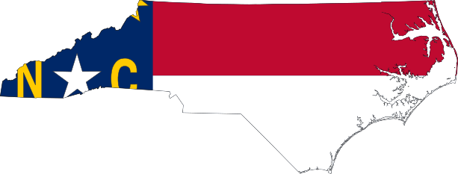
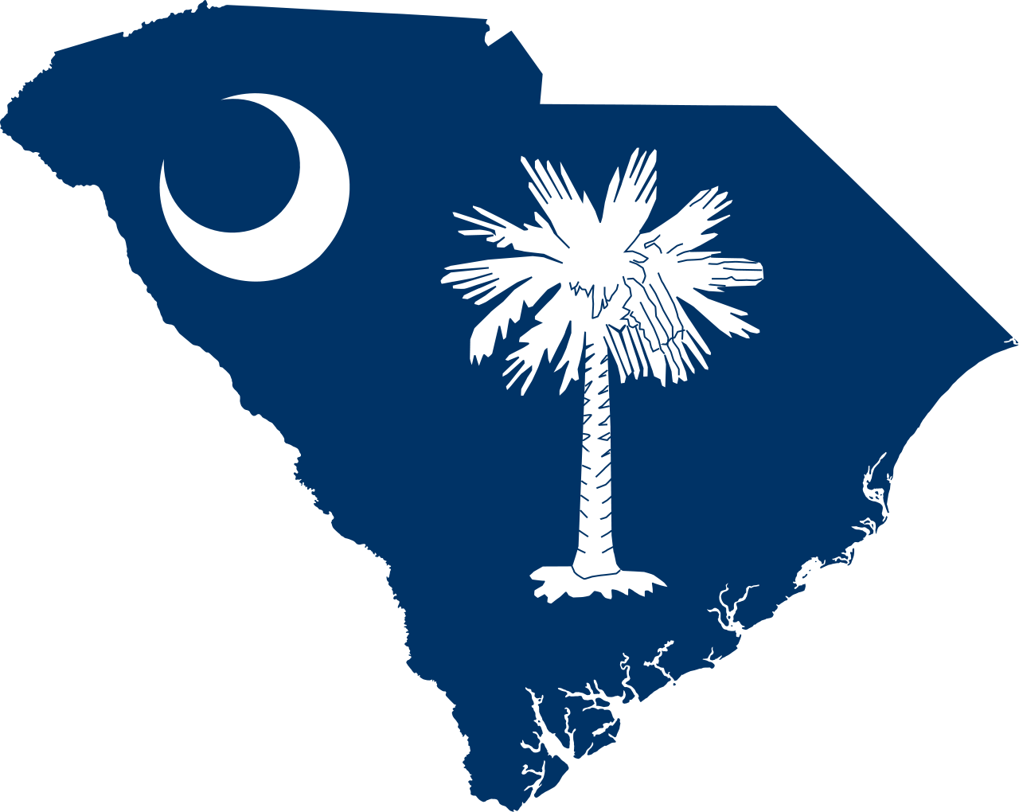
A Brewtastic Journey
Carolina Brew
North Carolina
First brewery est. 1986 – Weeping Radish
Currently (2021) 320 breweries & pubs
Largest number of craft breweries in the American South
South Carolina
First brewery est. 1993 – Palmetto Brewery
Currently (2018) 50 breweries

Slide 4
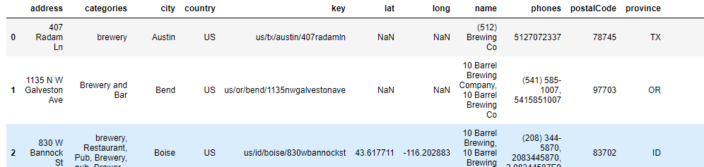
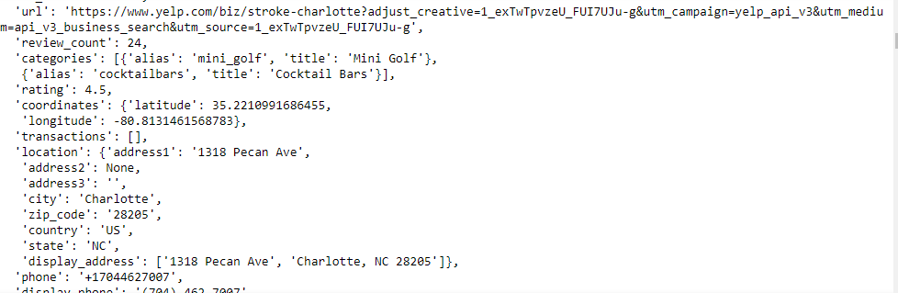
Extract
Data sets:
KAGGLE - BREWERIES AND BEER PUBS IN THE US (.CSV)
'https://api.yelp.com/v3/businesses/search’ (NC)
'https://api.yelp.com/v3/businesses/search’ (SC)
Initial Files:

Slide 5
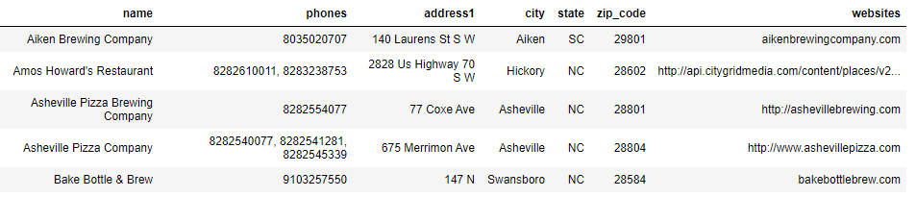
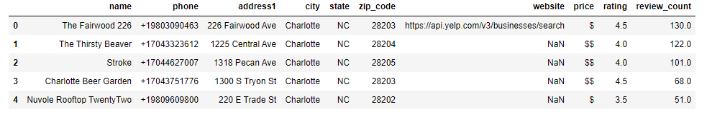
Transform
Kaggle file: remove columns, renamed columns, reorganized columns, removed rows with Nan and finally, sorted to North and South Carolina
Result: 77 Bars
Yelp file: created a list of rows of interest—name, phone, address, city, state, zip code,price, rating, and number of reviews. Then placed into a pandas DataFrame.
Result: 20 Bars NC & 20 Bars SC

Slide 6
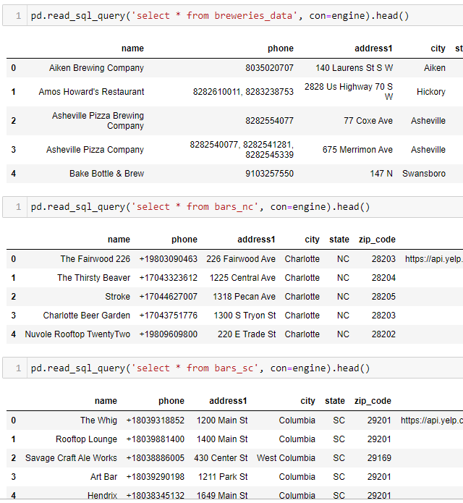
Transform
Sent tables to postgres – pgAdmin4
Confirmed all tables loaded

Slide 7

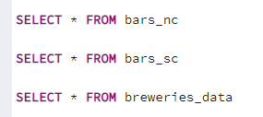
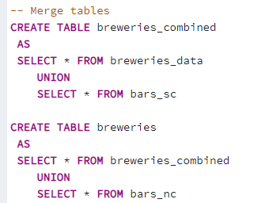
Transform
Altered Breweries_data by adding three columns
Confirmed tables were present in pgAdmin4
Merged tables to create one final table

Slide 8

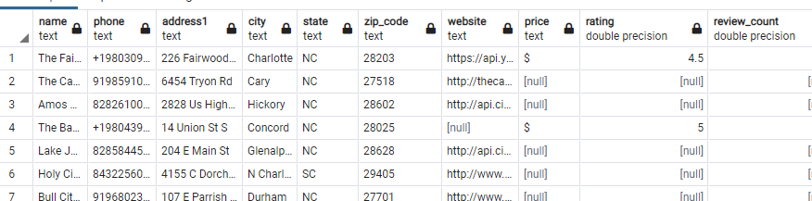
Load
Confirmed data in merged tables (FINAL TABLE: Breweries)
Confirmed size of table – 117 Rows

Slide 9
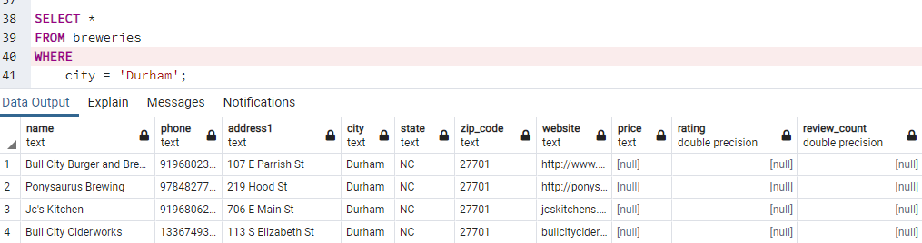
Test Case
Road Trip: Query for breweries in ‘Durham’

Slide 10
Conclusion
Extract
Yelp API
Kaggle CSV file
Transform
Adjusted table columns
Established listed and rows
Merged tables in pgAdmin4
Load
Confirmed merge and final table
Accomplished
Generated a production database displaying breweries in North Carolina and South Carolina

Slide 11

Q&A

